Slide 1

Lee Mobile Sales App Design
JABERSON J

Slide 2
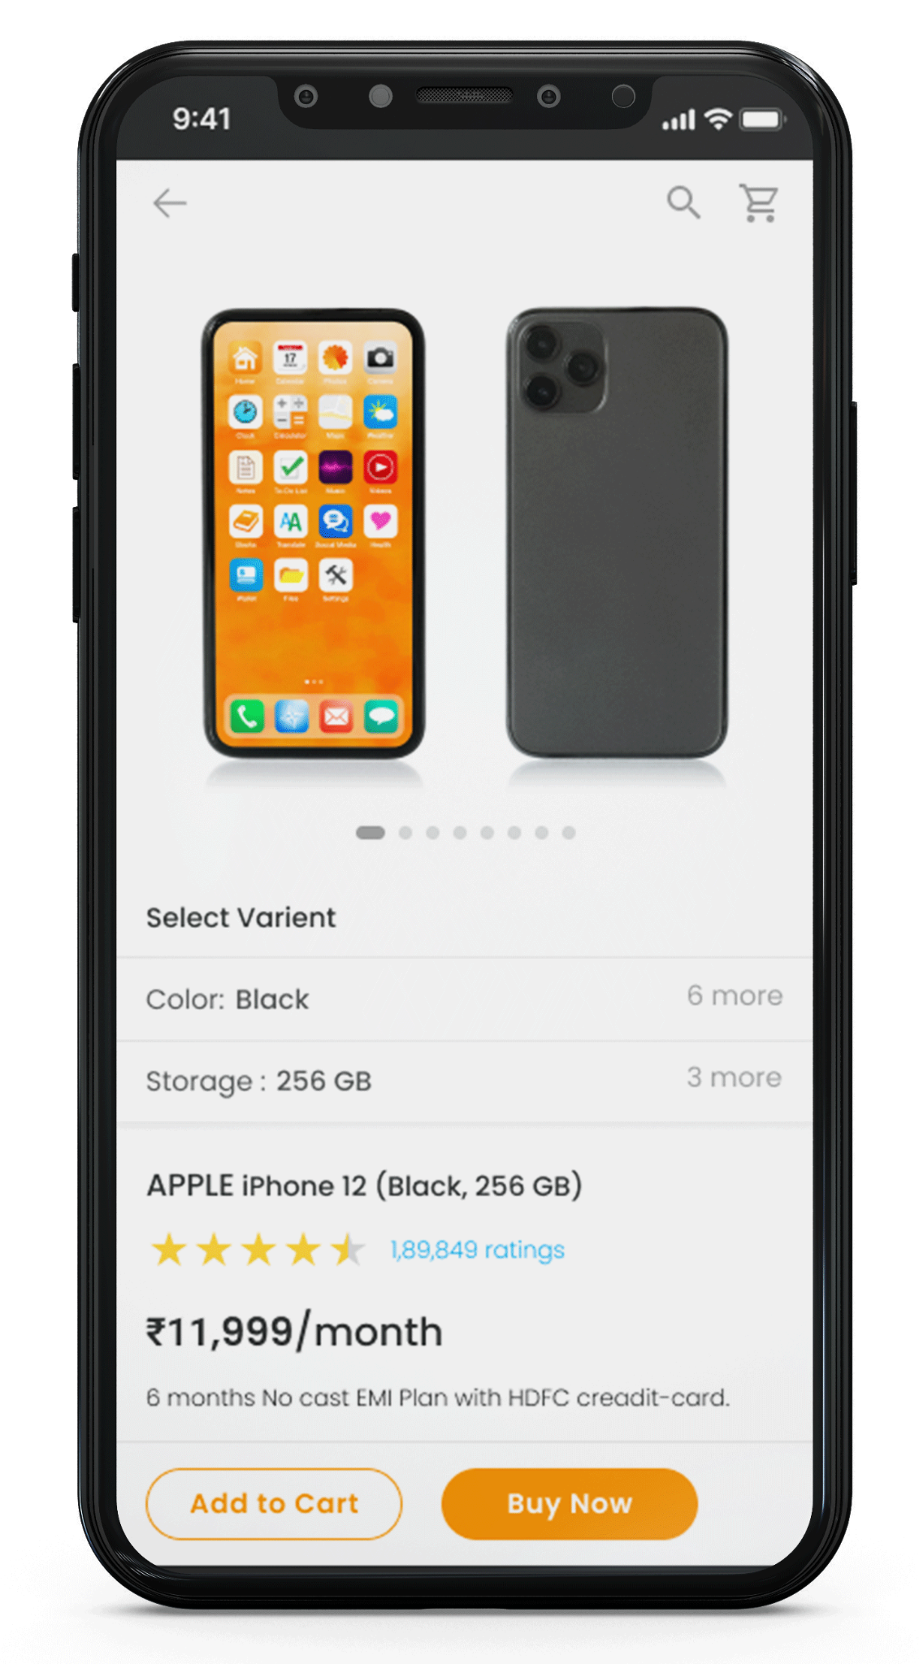
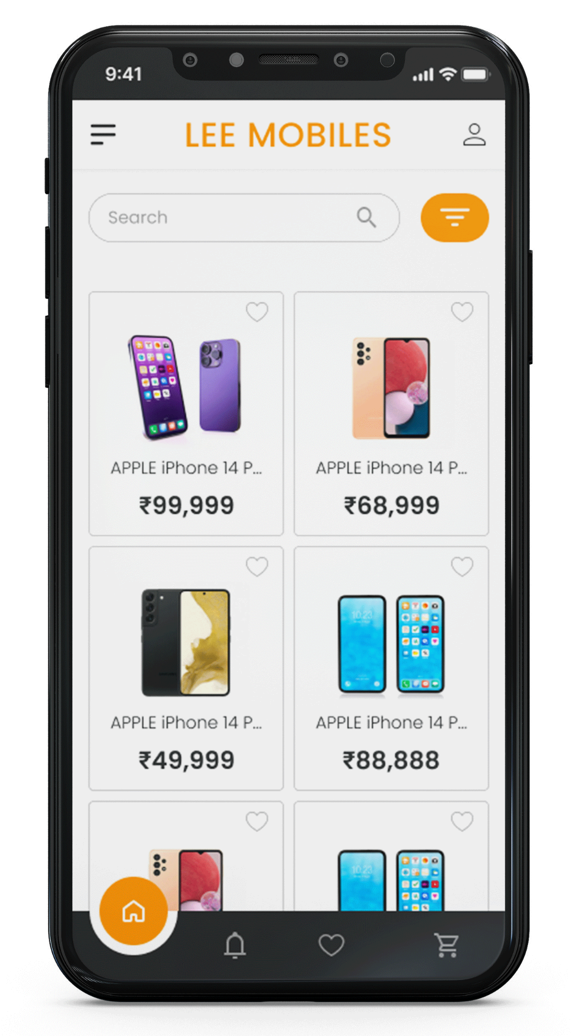
Project overview
The product:
This app will provide a user-friendly platform for local businesses to showcase and sell their products, and it will enable consumers to conveniently browse and purchase items directly from their mobile devices.
Project duration:
March 2023 to July 2023.

Slide 3
Project overview
The problem:
Busy workers and commuters don't have a time to go a mobile shop and asking review about the phone they want to buy.
The goal:
The goal of this project is design an app for Lee mobiles that allows users with a seamless and enjoyable shopping experience.

Slide 4
Project overview
My role:
Solo UI/UX Designer
Responsibilities:
Conducting interviews, paper and digital wireframing, low and high-fidelity prototyping, conducting usability studies, accounting for accessibility, and iterating on designs.

Slide 5
User research
Personas
Problem statements
User journey maps
Understanding
the user

Slide 6
User research: summary
I conducted interviews and created empathy maps to understand the users I’m designing for and their needs. A primary user group identified through research was working Peoples who don’t have time to go to the shop.
This user group confirmed initial assumptions about mobile sales app customers, but research also revealed that time was not the only factor limiting users buying mobiles at shop. Other user problems included want to know review of the mobile or want to see lot of collections or not possible go to mobile shop in-person.

Slide 7
User research: pain points
1
2
3
Time
Comparison
IA (Information Architecture)
working Peoples who don’t have time to go to the shop.
Platforms for ordering mobile phones don’t have compare option.
Text heavy menus in apps are often difficult to read and order.

Slide 8
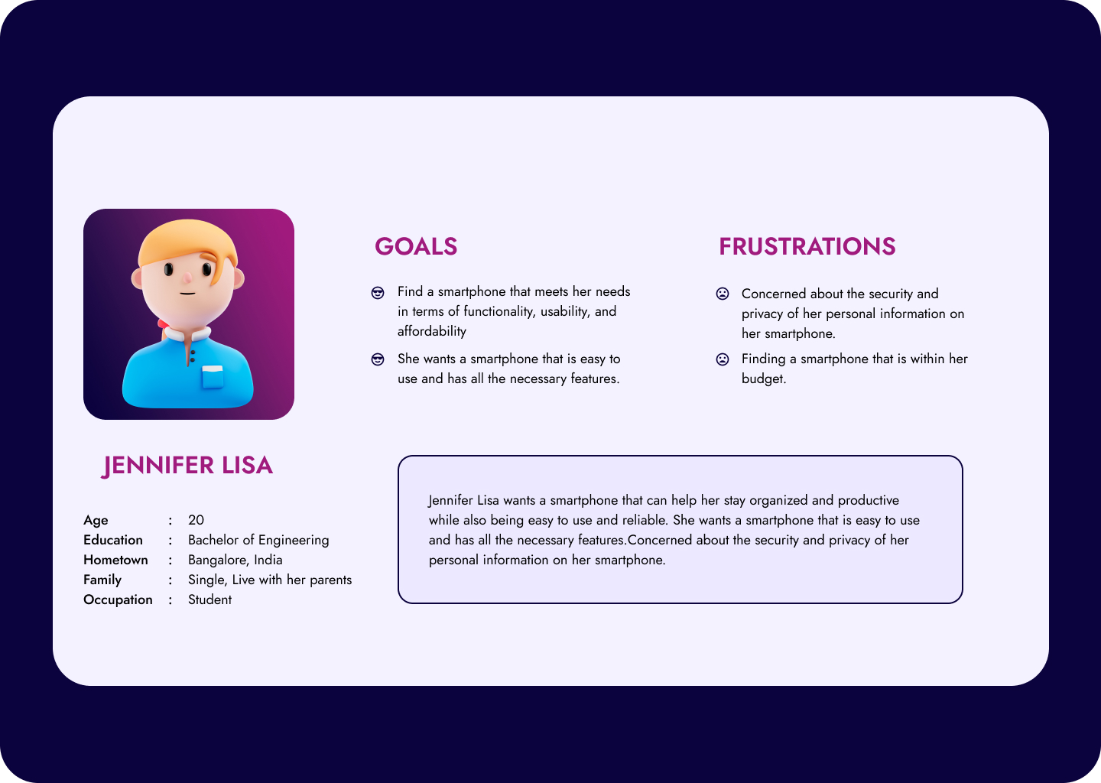
User Persona

Slide 9
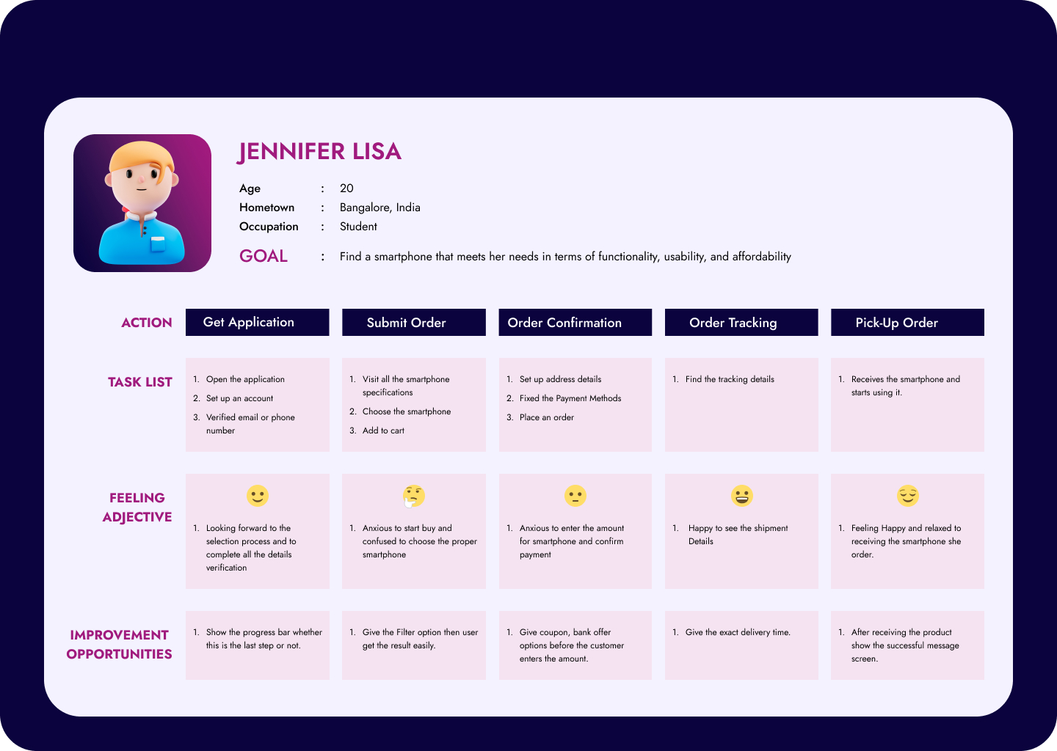
User Journey Map

Slide 10
Paper wireframes
Digital wireframes
Low-fidelity prototype
Usability studies
Starting
the design

Slide 11
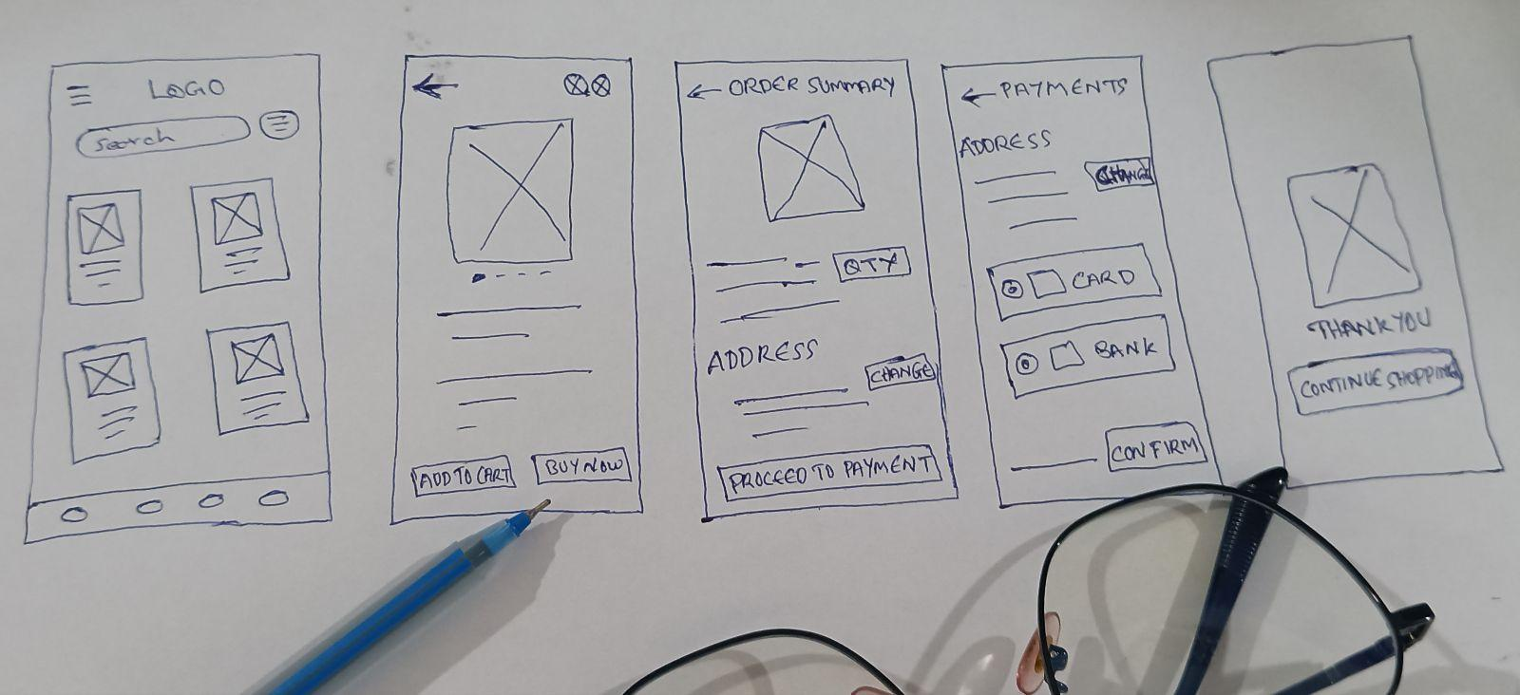
Paper wireframes
Taking the time to draft iterations of each screen of the app on paper ensured that the elements that made it to digital wireframes would be well-suited to address user pain points. For the home screen, I prioritized a quick and easy ordering process to help users save time.

Slide 12
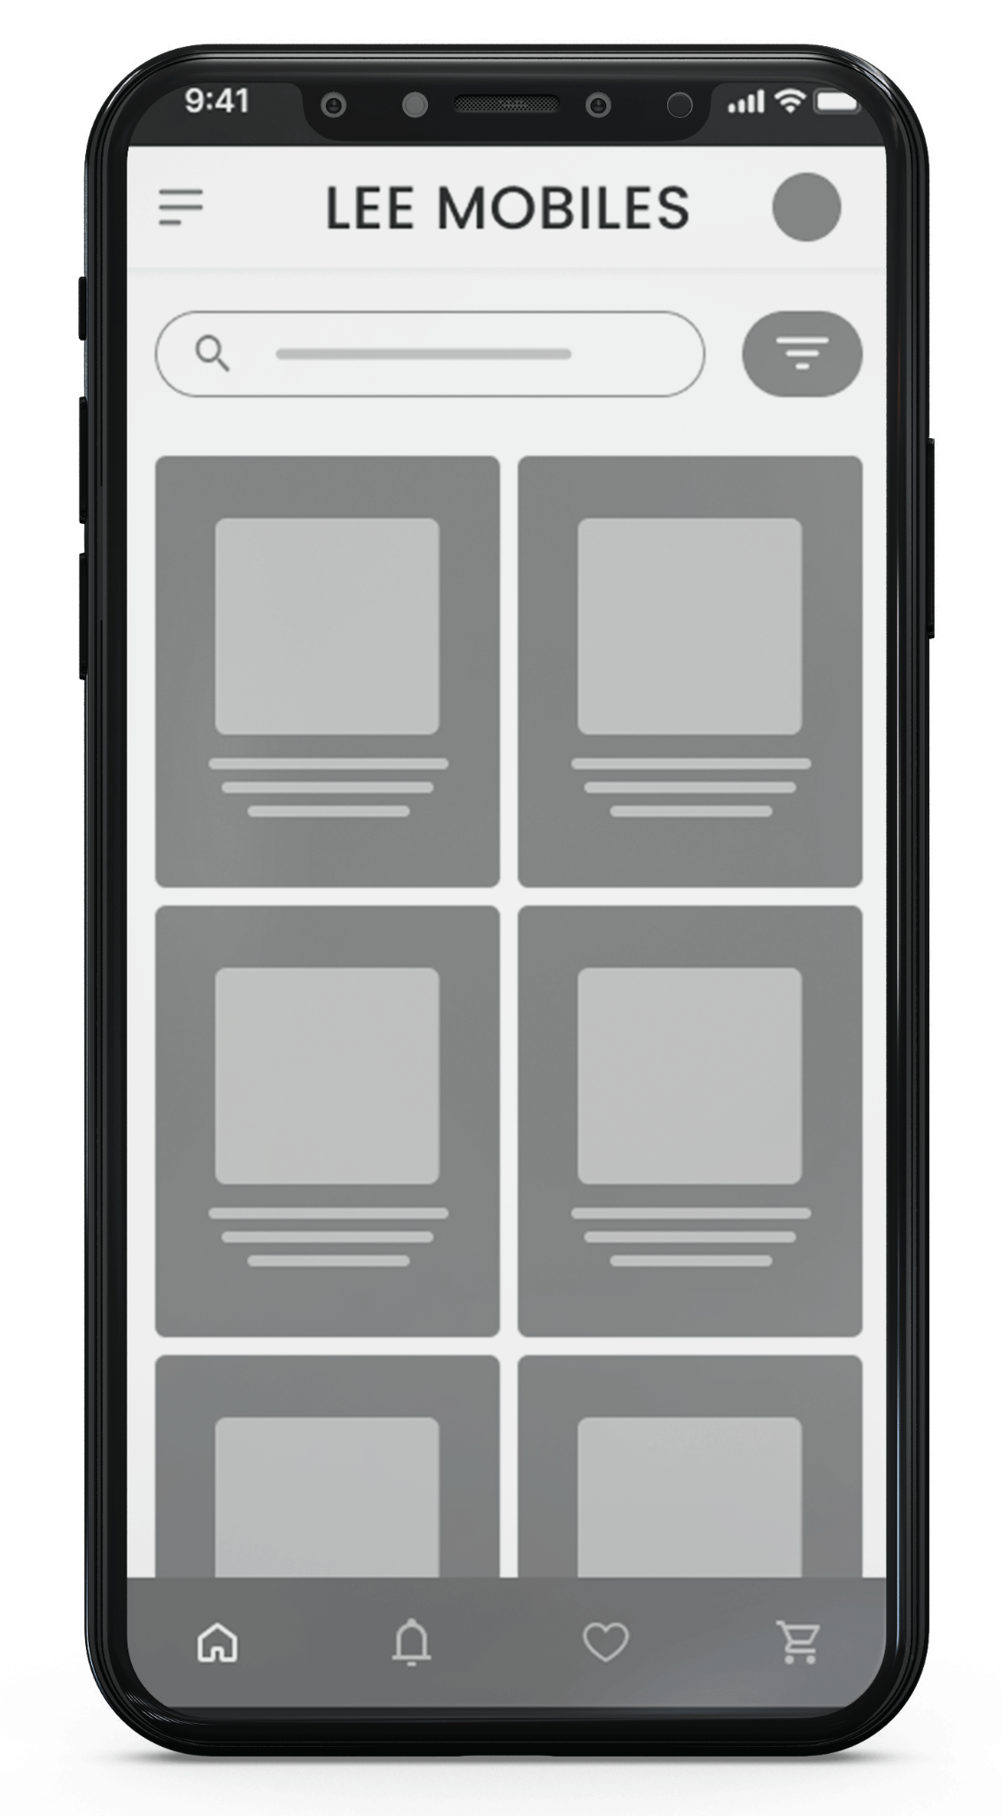
Digital wireframes
As the initial design phase continued, I made sure to base screen designs on feedback and findings from the user research.
This card at the bottom of the search bar makes it fast and easy for users to select the mobiles.

Slide 13
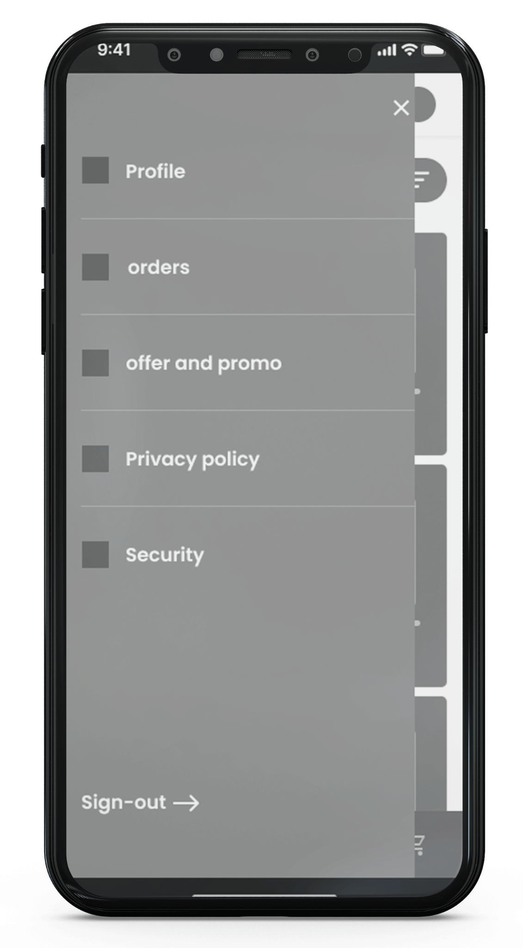
Digital wireframes
Easy access to navigation that’s screen reader friendly
Easy navigation was a key user need to address in the designs in addition to equipping the app to work with assistive technologies.

Slide 14
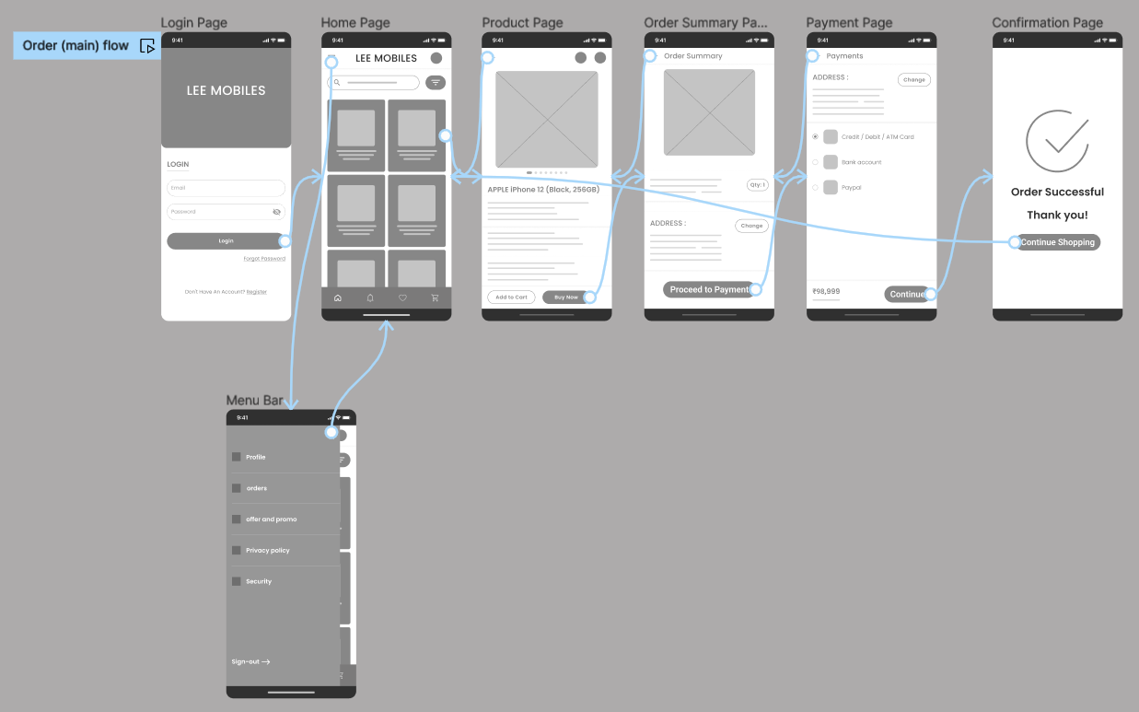
Low-fidelity prototype
Using the completed set of digital wireframes, I created a low-fidelity prototype. The primary user flow I connected was ordering a mobile phone, so the prototype could be used in a usability study.
View the Lee Mobile sales app. Lee Mobiles low-fidelity prototype

Slide 15
Usability study: findings
I conducted two rounds of usability studies. Findings from the first study helped guide the designs from wireframes to mockups. The second study used a high-fidelity prototype and revealed what aspects of the mockups needed refining.
Round 1 findings
Round 2 findings
1
Users want to order mobile quickly
1
Users want a cash on delivery option
2
Users want more payment method
2
Users want to “Cancel the order”

Slide 16
Refining
the design
Mockups
High-fidelity prototype
Accessibility

Slide 17
Mockups
Before usability study
After usability study
Early designs allowed for only the showcase option but after the usability studies, I added additional options to wishlist.when they first land on the screen. It provides an easy option for users to select a best mobile from their favorite list with the help of wishlist screen.

Slide 18
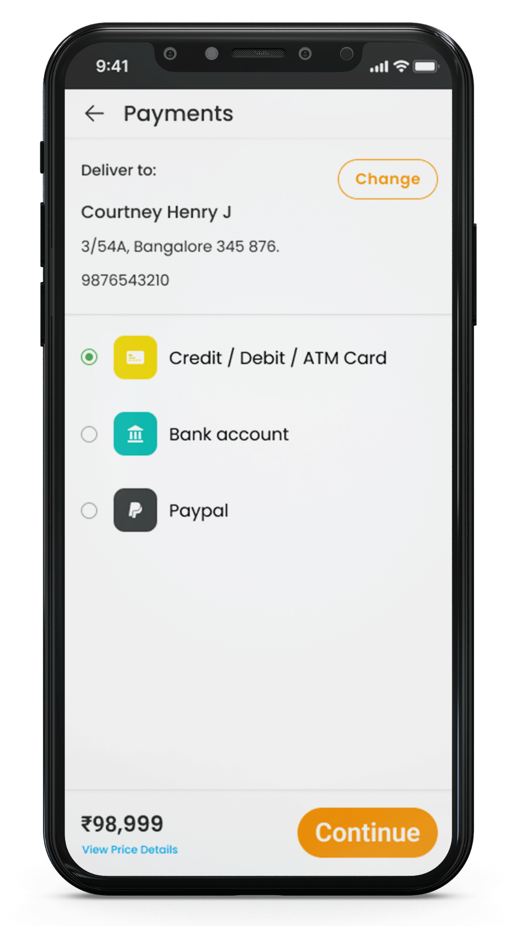
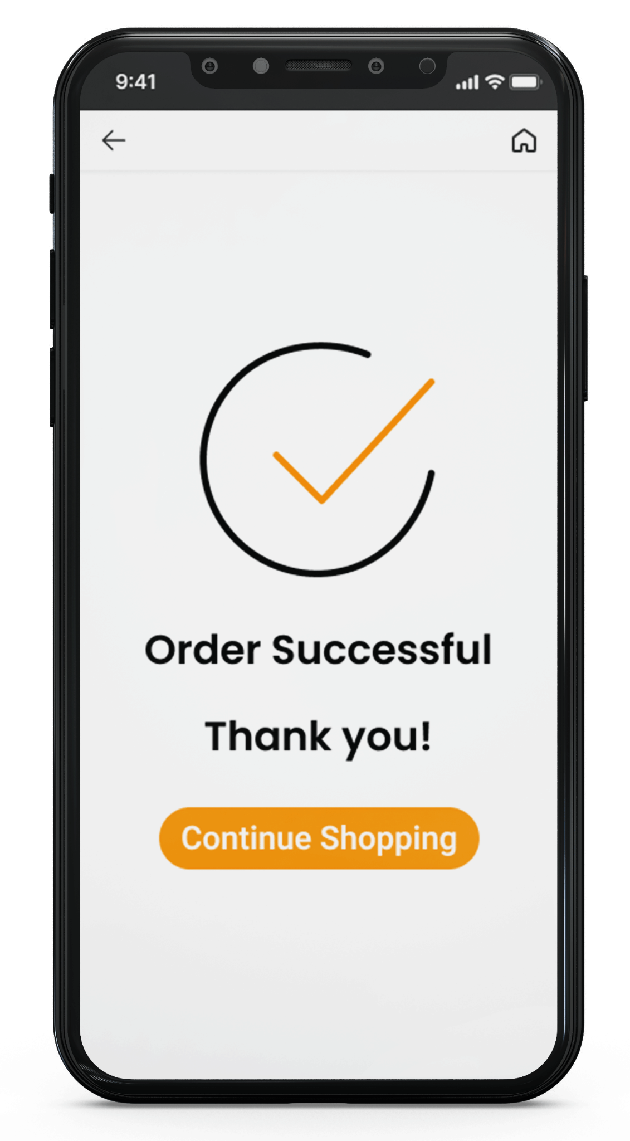
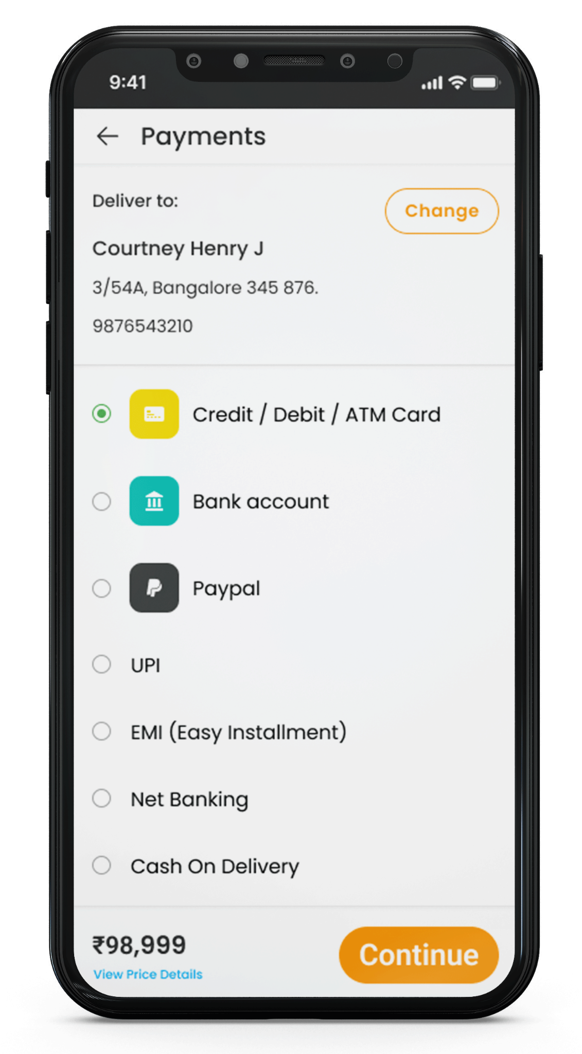
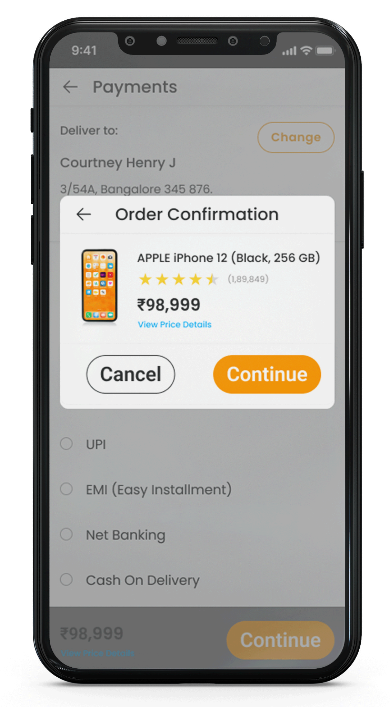
Mockups
Before usability study
After usability study
The second usability study revealed frustration with the checkout flow. I added more payment option and cash on delivery option.
I also added the Cancel option to the payment screen.

Slide 19

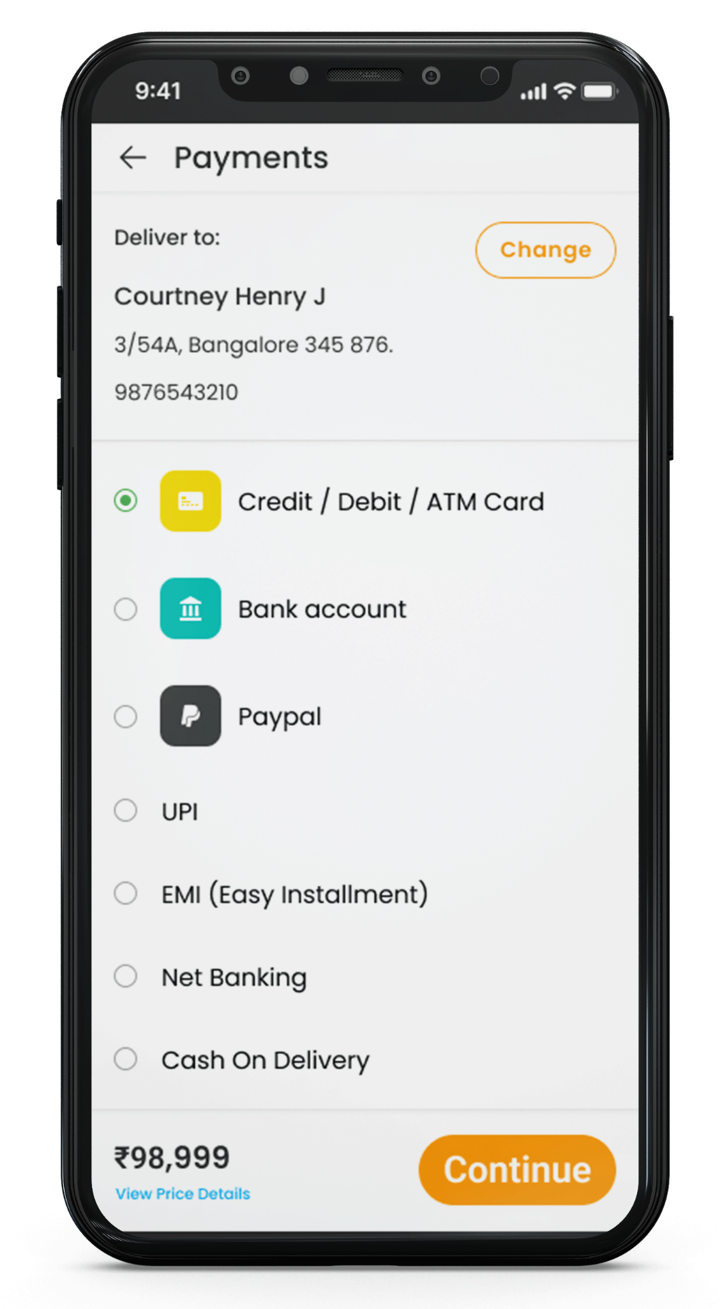
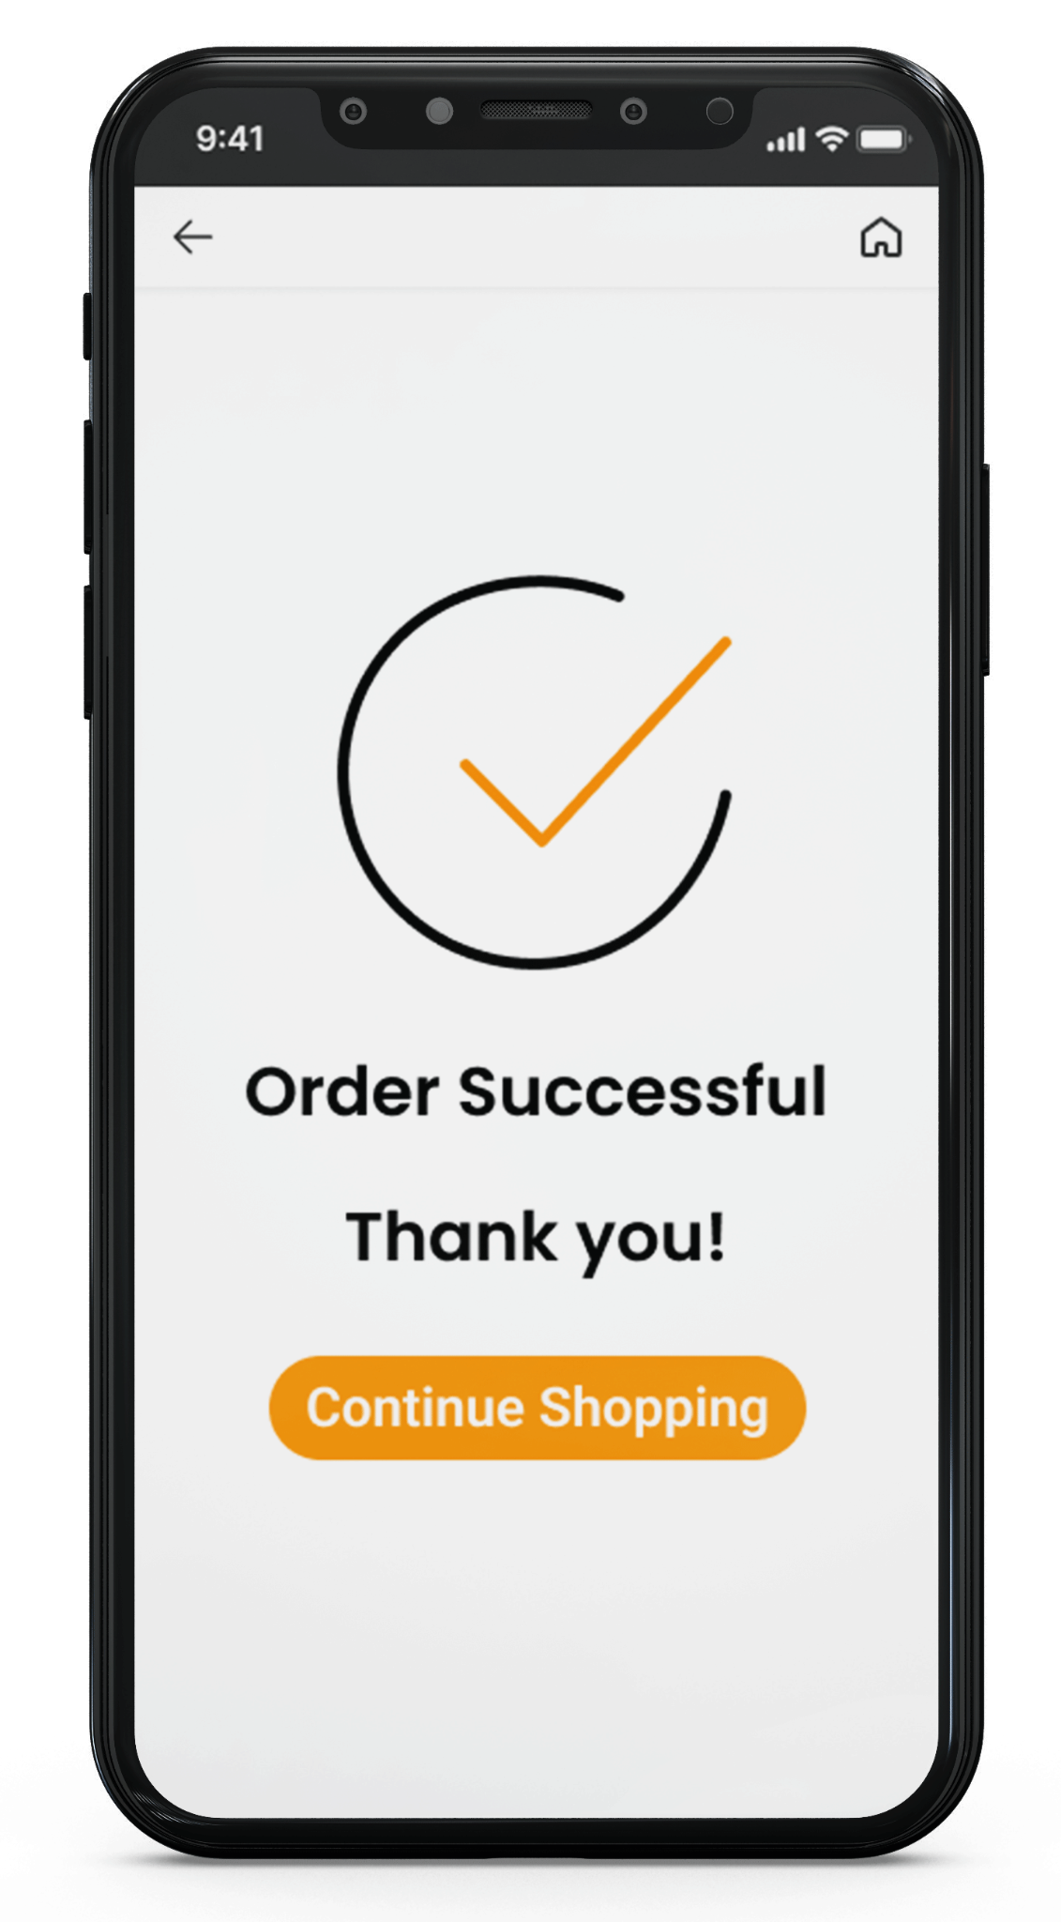
Mockups

Slide 20
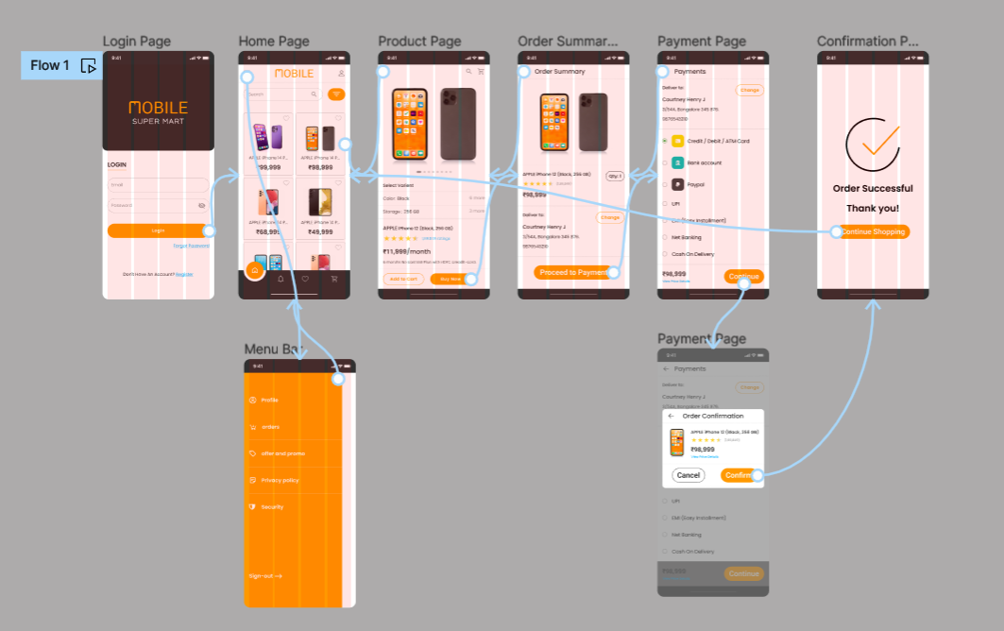
High-fidelity prototype
The final high-fidelity prototype presented cleaner user flows for order a mobile phone and checkout. It also meet user needs for a cash and delivery option as well as more customization.
View the Lee Mobile sales app. Lee Mobiles Hi-Fi prototype

Slide 21
Accessibility considerations
1
2
3
Provided access to users who are vision impaired through adding alt text to images for screen readers.
Used icons to help make navigation easier.
Used detailed imagery for mobiles to help all users better understand the designs.

Slide 22
Going forward
Takeaways
Next steps

Slide 23
Takeaways
Impact:
The app makes users feel like Lee mobiles really thinks about how to meet their needs.
One quote from peer feedback:
“The app made it so easy I would definitely use this app for my next mobile purchase.”
What I learned:
While designing the Lee mobiles app, I learned that the first ideas for the app are only the beginning of the process. Usability studies and peer feedback influenced each iteration of the app’s designs.

Slide 24
Next steps
1
2
Conduct another round of usability studies to validate whether the pain points users experienced have been effectively addressed.
Conduct more user research to determine any new areas of need.

Slide 25
Insert a few sentences summarizing the next steps you would take with this project and why. Feel free to organize next steps in a bullet point list.
Let’s connect!
Thank you for your time reviewing my work on the Lee Mobiles app! If you’d like to see more or get in touch, my contact information is provided below.
Email : jaberson98@gmail.com

